Slide 1
Anatomy of a Website
Content: Text, Media
+ HTML: Structure + Semantics
+ CSS: Presentation + Design
+ JS: Interactivity
= Your Website

Slide 2
HTML: "HyperText Markup Language"
Each tag has a "start tag", "end tag", some content in between, and optional attributes.

Slide 3
HTML
<!DOCTYPE html>
<html>
<head>
<meta charset="utf-8">
<title>Title of your page goes here</title>
</head>
<body> Bulk of your content here. </body>
</html>

Slide 4
What goes in the body?

Slide 5
Headlines
<h1>Header 1</h1>
<h2>Header 2</h2>
<h6>Header 6</h6>
Paragraphs
<p>Paragraph 1</p>
<p>Paragraph 2</p>
<p>Paragraph 3</p>

Slide 6
Line Breaks
<p> Imagine there's no Heaven <br>
It's easy if you try <br>
No hell below us <br>
Above us only sky <br> </p>
Imagine there's no Heaven
It's easy if you try
No hell below us
Above us only sky
Break has no closing tag as it doesnt encapsulate anything.

Slide 7
Lists (Unordered & Ordered)
<ul>
<li>Item 1</li>
<li>Item 2</li>
</ul>
Item 1
Item 2
<ol>
<li>Item 1</li>
<li>Item 2</li>
</ol>
Item 1
Item 2

Slide 8
Formatted Text
<em>Emphasized Info</em>
Emphasized Info
<strong>Important Info!</strong>
Important Info!
We can also use both <em> and <strong> in the Same
Paraghaph.

Slide 9

Images
<img src="http://www.google.com/images/srpr/logo1w.png" alt="Google">
Links
<a href="http://www.google.com">Google</a>
Google
<a href="http://www.google.com" target="_blank">Google</a>
Google (in new window)

Slide 10
Other Important Element
<div>
<span>
Html 5 tags
<section>
<article>
<aside>

Slide 11
HTML Comments
<!-- I can comment for humans here. -->
<!-- I can write a comment that spans multiple lines too. -->
HTML Readability
Bad Implementation:
<ul><li><a href=http://www.google.com>Google</a></li>
<LI>Yahoo</LI></UL>
Good Implementation:
<ul>
<li><a href=http://www.google.com>Google</a></li>
<li>Yahoo</li>
</ul>

Slide 12
HTML: Tables

Slide 13
The table element
The TABLE element contains all the elements that make up a
table - the header, rows, and columns.
<table border="1">
<thead>
<tr>
<th>Month </th>
<th>Savings </th>
</tr>
</thead>
<tbody>
<tr>
<td>January </td>
<td>$100 </td>
</tr>
</tbody>
</table>

Slide 14
HTML: Embeds

Slide 15
Iframes
You can use HTML to embed other webpages in your own page
using an iframe element pointing at a URL:
<iframe src="https://www.google.com" width="500" height="300"></iframe>
We can embed google doc, calender and other html page in an iframe

Slide 16
Multimedia Tags
<audio>
<video>
<canvas>

Slide 17
HTML: Forms

Slide 18
<form action="processform.php“ method="get"> <input type="text" name="first">
<input type="text" name="last">
<button type="submit">Send Data</button>
</form>
<input type="text" name="animal" value="Fox">
Types
type="email“,”date” etc

Slide 19
Button Element
<button type="submit">Submit order</button>
<button type="reset">Start over</button>
<button type="button">Customize</button>
Label element
<label for="animal"> Animal: </label>
<input type="text" name="animal" id="animal">
Label helps us to determine what the particular field is for

Slide 20
Checkboxes
Yes/No questions:
<label> Extra cheese?
<input type="checkbox" name="cheese"/> </label>
Multiple options:
Pizza Toppings:
<input type="checkbox" name="bacon“ id="bacon"> <label for="bacon">Bacon</label>
<input type="checkbox" name="cheese" id="cheese"> <label
for="cheese">Extra Cheese</label>

Slide 21
Radio buttons
<label for="small">Small</label>
<input type="radio" name="size" id="small" value="small">
<label for="medium">Medium</label>
<input type="radio" name="size" id="medium“ value="medium">
<label for="large">Large</label>
<input type="radio" name="size" id="large" value="large">
The select element
<select name="crust" id="crust">
<option value="thin">Thin</option>
<option value="thick">Thick</option>
<option value="cheese">Cheese</option>
</select>

Slide 22
Textarea element
<label>Delivery instructions: </label>
<textarea name="delivery"></textarea>
<textarea name="haiku" rows="3“ cols="40"></textarea>

Slide 23
CSS:Cascading Style Sheets

Slide 24
CSS in HTML
There is basically 3 ways to embed css in your HTML.
<link href=“style.css" type="text/css" />
With in the Head Tag
<style>
body {
color: yellow;
background-color: black;
}
</style>
With in individual Tag
<p style=“color:red;”>Hello World</p>

Slide 25
Selectors
The selector is used to select which elements in the HTML page
will be given the styles inside the curly braces.
Types
Element (tag) : p{color:red;}
Id (#): #id{color:red;}
Class (.) .class{width:20px;}
position in document (child element) p:first-child{height:20px;}
Grouping Element
a, .active, a.focus {
background-color: yellow;
}

Slide 26
Cascade rules
Generally:
id is more specific than a class, class is more specific than element.
the longer the selector, the more specific it is
If style rules are equally specific, the last one wins!
Example:
#a #b h1 { color: red; } /* winner! */
#a h1 { color: blue; }
Comments
/* Comment here */

Slide 27
CSS: Properties

Slide 28
Declarations (Property Value Pairs)
Each property can have one or more space
separated values.
font: italic 12px sans-serif;
color: #333;
background-color: red;
Properties: color / background-color
color: red;
color: #ff0000;
color: rgb(255, 0, 0);

Slide 29
Property: font-family
font-family: "Times New Roman", serif;
We can also use other font like google font.
Property: font-size
font-size: 1.5em;
font-size: 12px;
font-size: 100%;
Property: font-style
font-style: italic;
Property: font-weight
font-weight: bold;
Range: 100-900;

Slide 30
"Shorthand" properties
h1.hello {
font-style: italic;
font-weight: bold;
font-size: 10px;
font-family: sans-serif;
}
Can be shorthand to
h1.hello {
font: italic bold 10px sans-serif;
}
Other text properties
Line-height, text-align, text-decoration.

Slide 31
CSS: Grouping Elements

Slide 32
Block & Inline Elements
A browser generally renders a new line after any "block" elements in the HTML.
Examples:
inline: INPUT, A, IMG, BR, a few others...
block: P, H1, UL, LI, TABLE, almost everything else...
SPAN creates an inline element.
DIV creates an Block element.

Slide 33
Width & Height
The width and height properties can be used to resize block level elements and IMG elements.
Overflow
The overflow property specifies what happens when content overflows the specified dimensions. The default is "visible", which means it flows outside.
The “overflow:auto" can be used to tell the browser to add scrollbars if the content overflows.

Slide 34
CSS: Box Model

Slide 35
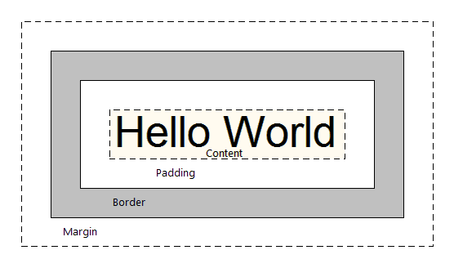
All elements are treated as boxes by the browser's rendering engine (either "inline" or "block" boxes).
A box consists of content, padding, border, and margin:

Slide 36
Margin
The margin is a transparent area around the box - the background of the box does not apply to it. It separates the box from other elements.
Example
margin: 15px; (15 pixels on all sides)
margin: 10px 5px 3px 20px; (10px on top, 5px right, 3px bottom, 20px left:)
Seperate like margin-top, margin-left;
Border
The border property styles the edge around the box and is specified as "thickness style color".
border: 1px solid #ff0000;
border-top: 4px dotted #000000;
border-top: 4px dotted #000000; border-bottom: 1px solid #ff0000;
Border Width (border-width: 10px;)
Border Style (dashed, double)
Border Color: border-color: rgb(0, 240, 0) or #343433;
border-color: #fff black #ff0000 #00ff00;

Slide 37
Padding
The padding property specifies whitespace between the border and the content.
Example
Padding: 15px; (15 pixels on all sides)
Padding: 10px 5px 3px 20px; (10px on top, 5px right, 3px bottom, 20px left:)
Seperate like padding-top, padding-left;

Slide 38
CSS: Positioning

Slide 39
The position property is used to specify a positioning scheme for an element. The default is "static" which puts the element in the "normal" flow.
<img src="logo.png"><img src="logo.png"><img src="logo.png">
In normal flow, block boxes flow from top to bottom, making a new line after every box.

Slide 40
The “position:relative" will still put the element in the normal flow, but then offset it according to top/left/right/bottom properties.
<div style="position: relative; left: 80px; top: 20px; height: 100px; background-color: yellow;">
Hello, hi!
</div>
The "absolute" value will take the element out of the normal flow and position it in relation to the window (or the closest non-static element).
The z-index property specifies the stack order of positioned elements, in the case that they are overlapping. The element with highest z-index goes on top.

Slide 41
CSS: Floats

Slide 42

The float property is used to float boxes on the sides of other boxes, allowing other content to flow around it. First used to wrap text around images.
<div style="border:1px solid black">
<img style="float:right" src=“logo.jpg">
Paragraph....
</div>

Slide 43
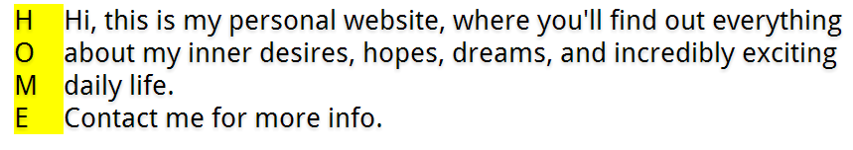
The float property can also be used to float non-IMG elements, but make sure to specify a width for the floated element.
<div>
<div style="float:left; width:50px; background-color:yellow; "> H<br>O<br>M<br>E
</div>
Hi, this is my personal website, where you'll find out everything about my inner desires, hopes, dreams, and incredibly exciting daily life.
</div>
<div>Contact me for more info.</div>

Slide 44
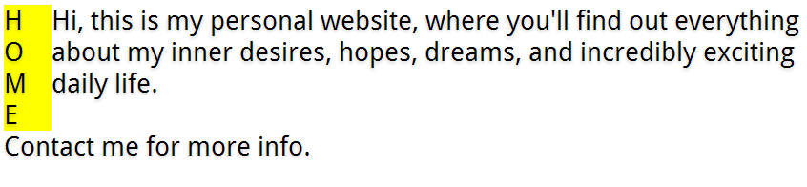
The clear property can be used to specify that an element should not wrap around floated elements above it.
<div>
<div style="float:left; width:50px; background-color:yellow; "> H<br>O<br>M<br>E
</div>
Hi, this is my personal website, where you'll find out everything about my inner desires, hopes, dreams, and incredibly exciting daily life.
</div>
<div style="clear:both">Contact me for more info.</div>

